Slide 1
Canadian Bioinformatics Workshops
www.bioinformatics.ca

Slide 2
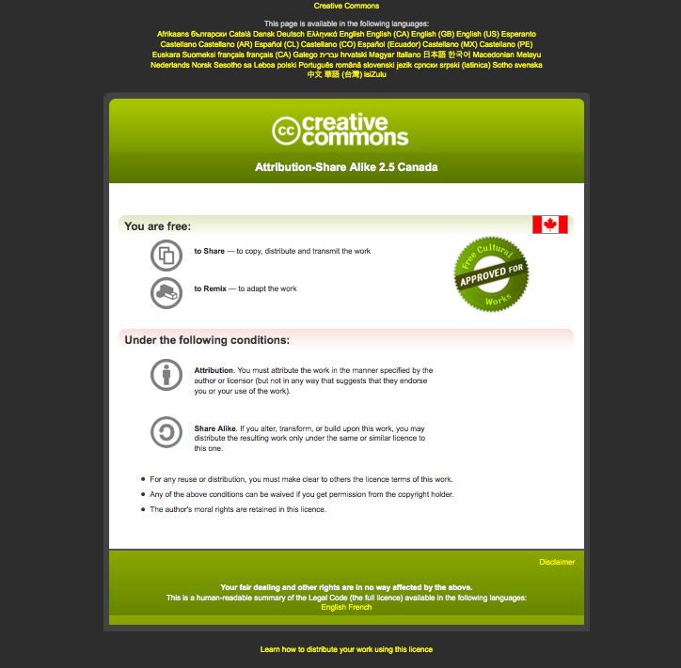

Slide 3
Beyond genome sequencing
Asim Siddiqui
Bioinformatics Workshop
Next Generation Sequencing

Slide 4
Questions about the genome
Obtaining a genome sequence is a one step towards understanding biological processes
Questions that follow from the genome are:
  What is transcribed?
  Where do proteins bind?
  What is methylated?
In other words, how does it work?

Slide 5
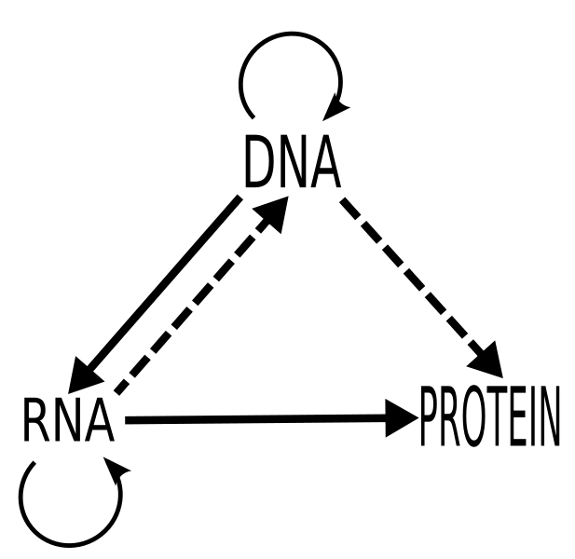
Central dogma of molecular biology

Slide 6
The Transcriptome
The transcriptome is the entire set of RNA transcripts in the cell, tissue or organ.
The transcriptome is cell type specific and time dependant i.e. It is a function of cell state
The transcriptome can help us understand how cells differentiate and respond to changes in their environment.

Slide 7
Transcriptome complexity
Transcripts may be:
  Modified
  Spliced
  Edited
  Degraded
Transcriptome is substantially more complex than the genome and is time variant.

Slide 8
Historic measurements
Northern blots
RT-PCT
FRET
The above assays must be targeted to a specific locus

Slide 9
ESTs
ESTs were the first genome wide scan for transcriptional elements
Different library types:
  Proportional
  Normalized
  Subtractive
Can be sequenced from the 5’ or 3’ end

Slide 10
“Hello Mr Chips”
Microarray chips introduced in 90’s
Essentially a parallel Northern blot
  Probes placed on slides
  RNA -> cDNA, labelled with fluorescent dye and hybridized.
  Fluorescence measured
Chips have been highly successful
Simplified analysis
Useful when there is no genome sequence
Linear signal across 500 fold variation
Standardization has aided use in medical diagnostics
  E.g. Mammaprint

Slide 11
Chips: pros and cons
Advantages
  Do not require a genome sequence
  Highly characterised, with many s/w packages available
  One Affymetrix chip FDA approved
Disadvantages
  Measurements limited to what’s on the array
  Hard to distinguish isoforms when used for expression
  Can’t detect balanced translocations or inversions when used for resequencing

Slide 12
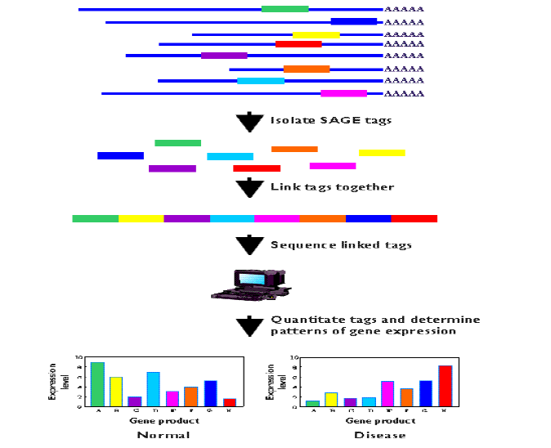
SAGE

Slide 13
SAGE
Advantages
  Digital count for each transcript
  Novel transcript discovery
Disadvantages
  Alternative transcripts may share a tag
  The tag may map to multiple genomic locations
  Doesn’t work well if genome is unknown
  Expensive

Slide 14
“Goodbye Mr Chips”
Large sale EST and SAGE libraries are expensive with Sanger sequencing
Next gen sequencing has dropped the cost by a factor of 100
Papers have demonstrated large numbers alternatively spliced and novel transcripts
Chips are established, especially in the diagnostic market, but...their days are numbered

Slide 15
mRNA-seq
Basic work flow
  Align reads (sometimes to transcriptome first and then the genome)
  Tally transcript counts
  Align tags to spliced transcripts
  Add to transcript counts

Slide 16
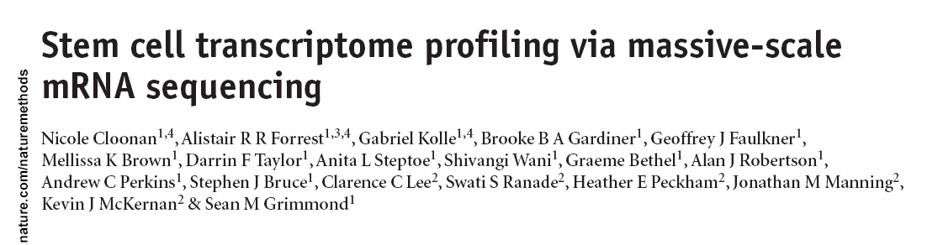
Cloonan et al. 2008
Used SOLiD to generate 10Gb of data from mouse embryonic stem cells and embryonic bodies
Used a library of exon junctions to map across known splice events

Slide 17
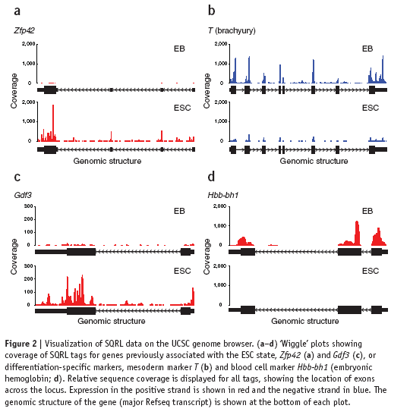

Distribution of tags

Slide 18
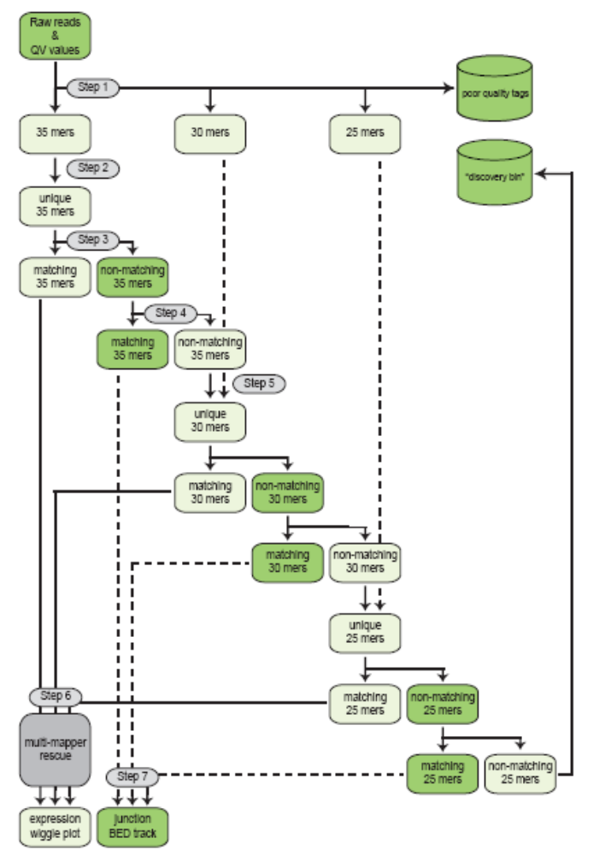
Alignment strategy

Slide 19
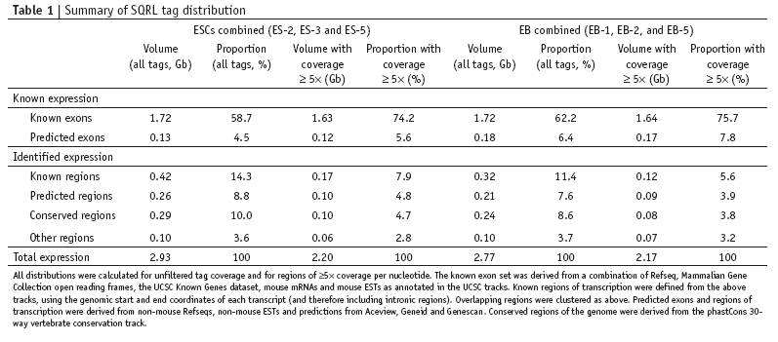
Tag locations

Slide 20
Additional papers
  Bainbridge et al 2006 – used 454 to investigate the transcriptome of ES cells
Mortazavi et al 2008 – used Illumina to investigate transcription in liver cells

Slide 21
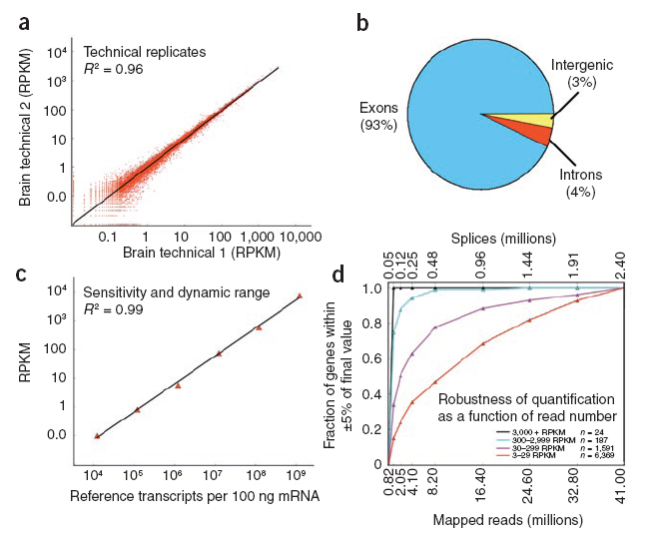
Mortazavi et al 2008

Slide 22
General issues
Coverage across the transcript may not be random
Some reads map to multiple locations
Some reads don’t map at all
Reads mapping outside of known exons may represent
  New gene models
  New genes

Slide 23
Size of the transcriptome
Carter et al (2005)
  Using arrays estimated 520,000 to 850,000 transcripts per cell.
  Use upper limit and estimate average transcript size of 2kb
  Transcriptome ~2GB
Transcriptome cost ~ genome cost

Slide 24
The Boundome
DNA binding proteins control genome function
Histones impact chromatin structure
Activators and repressors impact gene expression
The location of these proteins helps us understand how the genome works

Slide 25
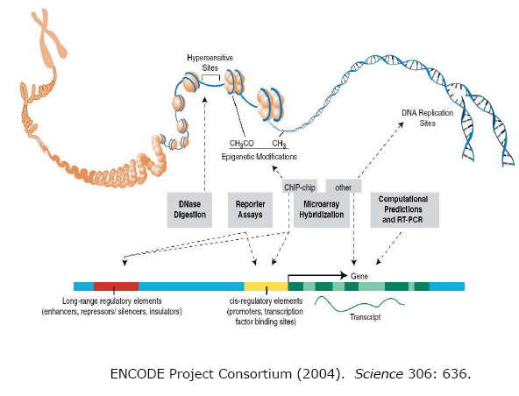

Slide 26
Finding protein binding sites
EMSA
ChIP
ChIP-chip
ChIP-seq

Slide 27
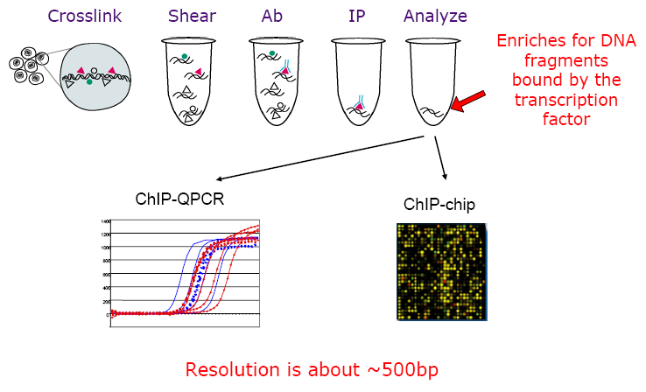
ChIP

Slide 28
Chip-Seq
Instead of probing against a chip, measure directly
Basic work flow
  Align reads to the genome
  Identify clusters and peaks
  Determine bound sites

Slide 29
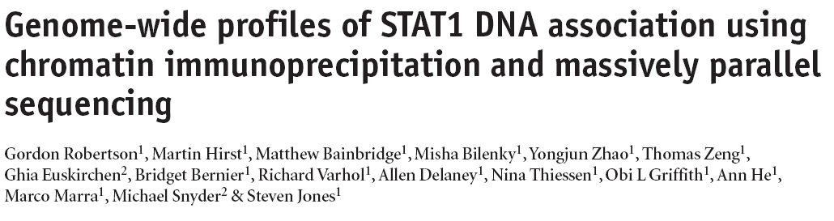
Robertson et al. 2007
Used Illumina technology to find STAT1 binding sites
Comparisons with two ChIP-PCR data sets suggested that ChIP-seq sensitivity was between 70% and 92% and specificity was at least 95%.

Slide 30
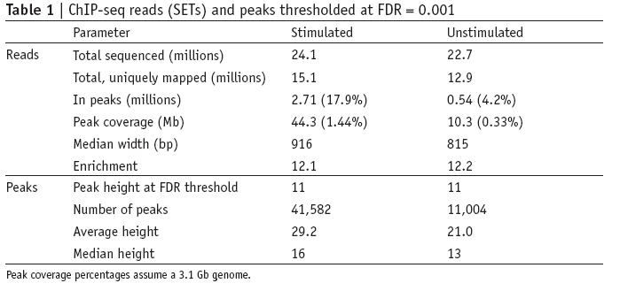
Tag statistics

Slide 31
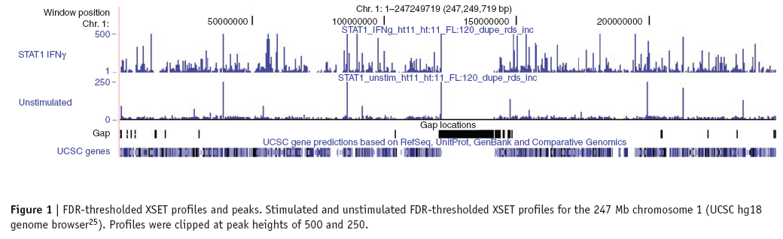
Typical Profile

Slide 32
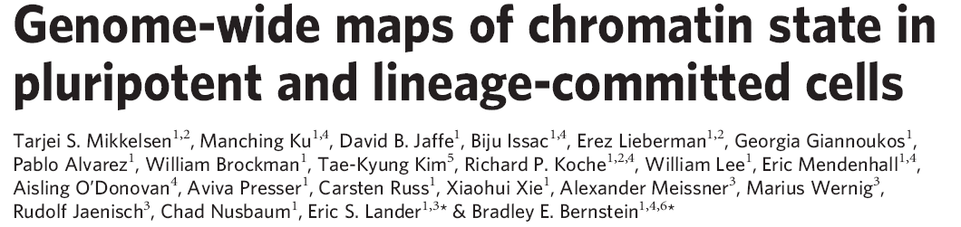
Mikkelsen et al., 2007
Performed a comparison with ChIP-chip methods ~98% concordance

Slide 33
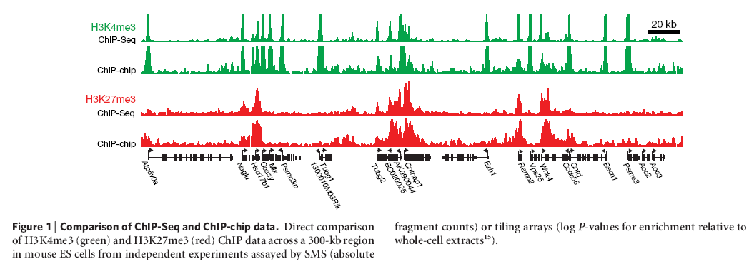
Comparison with ChIP-seq

Slide 34
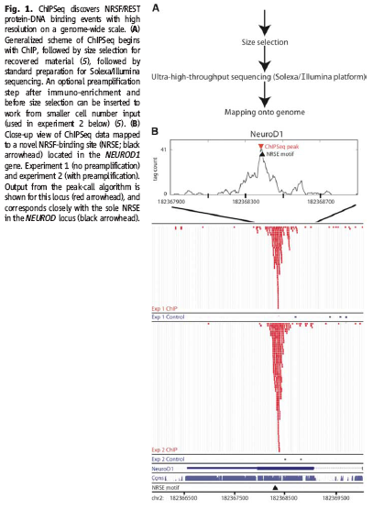
Johnson et al, 2007
Gene known to be regulated by NeuroD1 for many years
Traditional biochemistry and bioinformatics failed to find the site.
Site assumed to be 100’s kb upstream
ChIP-seq found a site with weak match to the consensus motif in exon 1

Slide 35
The Methylome
In methylated DNA, cytosines are methylated.
This leads to silencing of genes in the region e.g. X inactivation
It is yet another form of transcriptional control and together with histone modifications a key component of epigenetics

Slide 36
Bi-sulphite sequencing
Converts un-methylated cytosines to uracil (which becomes thymine when converted to cDNA)
Experimental procedure is difficult
Sequence alignment is tricky, but the basic concepts hold

Slide 37
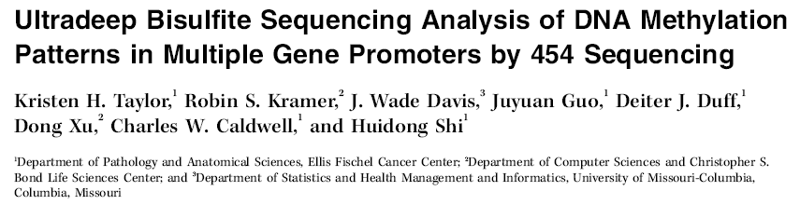
Taylor et al, 2007
Targeted sequencing reduced alignment difficulties
Used dynamic programming to identify alignments of sequences against an in silico bisulphate converted sequence of the target amplicon regions

Slide 38
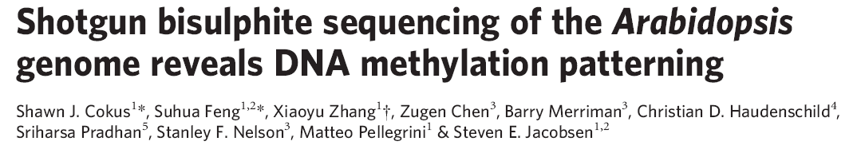
Cokus et al, 2008
Used Illumina shotgun sequencing
Tested reads against every possible methylation pattern and retained unique hits

Slide 39
The basic workflow
All of these analyses follow the same basic pattern
  Align reads
  Count
  Analyze

Slide 40
Metagenomics
Craig Venter’s sequencing of the sea one of the earliest and most well known examples
  Used Sanger sequencing
Many recent studies including
  Angly et al – studied ocean virome
  Cox-Foster et al – studied colony collapse disorder
All use 454 for its longer read length and target amplification of 16S or 18S ribsomal subunits

Slide 41
Summary
Basic processing algorithm is the same
Results are analyzed using standard statistical practices established in work using earlier experimental methods
Metagenomics covers a new type of sequencing not easily performed with Sanger

